Slide 1
OOP152 – OBJECT-ORIENTED PROGRAMMING
2024

Slide 2
Conditional statements and logical expressions

Slide 3
More complex methods
OUTLINE
Conditional Statements
Relational Operators
Logical Operators
Conditional statements
Chaining and Nesting
Flag Variables
The return statement
Validating input
Recursive Methods
Recursive Stack Diagram
Binary Numbers

Slide 4
Relational operators

Slide 5
More complex methods
Relational Operators:
Relational operators are used to compare two values.
They evaluate to either true or false.
Types of Relational Operators:
Equality (==): Checks if two values are equal.
Example: x == y
Inequality (!=): Checks if two values are not equal.
Example: x != y

Slide 6
Control flow
Relational Operators:
Types of Relational Operators:
Greater Than (>): Checks if one value is greater than another.
Example: x > y
Less Than (<): Checks if one value is less than another.
Example: x < y
Greater Than or Equal To (>=): Checks if one value is greater than or equal to another.
Example: x >= y
Less Than or Equal To (<=): Checks if one value is less than or equal to another.
Example: x <= y

Slide 7
More complex methods
Relational Operators:
Boolean Result:
The result of using a relational operator is a boolean value (true or false), which belongs to the boolean data type.
Syntax Caution:
Equality vs. Assignment: In Java, == is used for comparison, whereas = is used for assignment.
Invalid Operators: Operators like =< or => do not exist. Use <= and >= instead.

Slide 8
Control flow
Relational Operators:
Type Compatibility:
Both sides of a relational operator must be compatible.
Comparing different data types (e.g., int vs. double) leads to automatic type conversion.
Example: 5 < 6.0 becomes 5.0 < 6.0

Slide 9
More complex methods
Relational Operators:
Usage with Strings:
Do not use == or != for string comparison as they check reference equality, not content.
Use .equals() method for comparing the content of strings.
Example:
String fruit1 = "Apple";
String fruit2 = “Orange";
System.out.println(fruit1.equals(fruit2));

Slide 10
logical operators

Slide 11
More complex methods
Logical Operator:
Overview of Logical Operators
Java uses three primary logical operators: && (and), || (or), and ! (not).
These operators are used to form complex Boolean expressions.
Examples of Logical Operators
&& operator: x > 0 && x < 10 is true if x is greater than zero AND less than ten.
|| operator: evenFlag || n % 3 == 0 is true if either even Flag is true OR n is divisible by 3.
! operator: !evenFlag is true if even Flag is not true (negation).

Slide 12
More complex methods
Logical Operator:
Short Circuit Evaluation
Describes how Java evaluates logical expressions efficiently by not evaluating the second operand when the first is conclusive:
true || anything immediately returns true without evaluating "anything".
false && anything immediately returns false without evaluating "anything".
This optimization can save computation time and prevent errors.

Slide 13
Control flow
Logical Operator:
De Morgan’s Laws
Useful for negating expressions containing logical operators:
!(A && B) is equivalent to !A || !B
!(A || B) is equivalent to !A && !B
Operator precedence: ! takes precedence over && and ||.

Slide 14
More complex methods
Logical Operator:
Applying De Morgan’s to Relational Operators
Transformations using De Morgan’s laws also apply to combinations with relational operators:
!(x < 5 && y == 3) translates to x >= 5 || y != 3
!(x >= 1 || y != 7) translates to x < 1 && y == 7
Reading transformations aloud can aid in understanding their logical flow.

Slide 15
Control flow
Logical Operator:
Examples in Conditional Statements
Using logical operators in conditions:
if (x > 0 && x < 10) {
System.out.println("x is between 0 and 10.");
}
if (!(x >= 1 || y != 7)) {
System.out.println("x is less than 1 and y is 7.");
}

Slide 16
Conditional statements

Slide 17
More complex methods
Conditional Statement
Introduction to Conditional Statements
Conditional statements are crucial for checking conditions and making decisions within programs.
The if Statement
Simplest form of conditional execution.
Executes a block of code if the condition is true.
if (x > 0) {
System.out.println("x is positive");
}

Slide 18
Control flow
Conditional Statement
The if-else Statement
Provides two branches for execution; one if the condition is true, and another if it is false.
Example Code:
if (x % 2 == 0) {
System.out.println("x is even");
} else {
System.out.println("x is odd");
}

Slide 19
More complex methods
Conditional Statement
Importance of Braces ({})
Using braces is recommended even for single statements to prevent errors and enhance code readability.
Braces define the block of code that should execute conditionally.

Slide 20
Control flow
Conditional Statement
Common Mistakes and Misleading Code
Omitting braces can lead to misleading code structures, which might cause bugs.
Misleading Example:
if (x > 0)
System.out.println("x is positive");
System.out.println("x is not zero");

Slide 21
More complex methods
Conditional Statement
Common Mistakes and Misleading Code
Omitting braces can lead to misleading code structures, which might cause bugs.
Misleading Example:
if (x > 0)
System.out.println("x is positive");
System.out.println("x is not zero");
The second System.out.println will always execute, regardless of the condition, because it's not inside the if statement.

Slide 22
Control flow
Conditional Statement
Proper Indentation and Bracing
Proper indentation and the use of braces can prevent logic errors, such as those seen in infamous coding mistakes like Apple’s “goto fail” bug.
Correctly Indented Example:
if (x > 0) {
System.out.println("x is positive");
}
System.out.println("x is not zero");
Only the first print statement is conditionally executed based on x being positive.

Slide 23
Chaining and nesting

Slide 24
More complex methods
Chaining and Nesting Conditional Statements
Chaining Conditional Statements
Involves using a series of if, else if, and else statements to handle multiple conditions..
Example:
if (x > 0) {
System.out.println("x is positive");
} else if (x < 0) {
System.out.println("x is negative");
} else {
System.out.println("x is zero");
}

Slide 25
More complex methods
Chaining and Nesting Conditional Statements
Chaining Conditional Statements
Chains can be lengthy, but readability can be maintained with proper indentation.
Ensuring that all statements and braces are aligned reduces syntax errors.

Slide 26
More complex methods
Chaining and Nesting Conditional Statements
Nesting Conditional Statements
Consists of placing one conditional statement inside another.
Example:
if (x == 0) {
System.out.println("x is zero");
} else {
if (x > 0) {
System.out.println("x is positive");
} else {
System.out.println("x is negative");
}
}

Slide 27
More complex methods
Chaining and Nesting Conditional Statements
Nesting Conditional Statements
The outer condition has two branches; the second branch includes another conditional statement.
Nested structures allow for complex decision-making but can quickly become hard to read.
Importance of Good Indentation
Essential for clarity, especially with nested and chained conditionals.
Helps to visually organize the code, making the logical structure apparent to the reader.

Slide 28
Flag variables

Slide 29
More complex methods
Flag Variables
Summary of Flag Variables in Programming
Boolean Variables
Used to store true or false values.
Example:
boolean flag;
flag = true;
boolean testResult = false;

Slide 30
More complex methods
Flag Variables
Declaring and Using Flag Variables
Initialization and Declaration
A boolean variable is declared and can be immediately assigned.
Example:
boolean evenFlag = (n % 2 == 0); // true if n is even
boolean positiveFlag = (x > 0); // true if x is positive

Slide 31
More complex methods
Flag Variables
Purpose of Flag Variables
Simplifies Code Readability
Parentheses are optional but improve clarity.
Flags signal conditions within the program.

Slide 32
Control flow
Flag Variables
Utilizing Flag Variables in Conditional Statements
Usage in Conditionals
Directly use boolean flags in if statements without comparing to true.
Examples:
if (evenFlag) {
System.out.println("n was even when I checked it");
}
if (!evenFlag) {
System.out.println("n was odd when I checked it");
}

Slide 33
Return statements

Slide 34
More complex methods
The Return Statement
Purpose of the Return Statement
Terminates a method before reaching its end.
Useful for controlling method flow based on conditions

Slide 35
Control flow
The Return Statement
Example Scenario: Error Handling
The method printLogarithm takes a double value x.
Checks if x is less than or equal to zero.
If true, displays an error and exits the method immediately using return.

Slide 36
Control flow
The Return Statement
Code Example:
public static void printLogarithm(double x) {
if (x <= 0.0) {
System.err.println("Error: x must be positive.");
return;
}
double result = Math.log(x);
System.out.println("The log of x is " + result);
}

Slide 37
Control flow
The Return Statement
Code Example:
System.err.println is used for error messaging.
This method prints an error to System.err if x <= 0.
System.err vs. System.out
System.err is typically used for error messages and warnings.
Outputs to System.err may appear in a different colour or separate window, depending on the development environment.

Slide 38
Control flow
The Return Statement
Flow of Execution
If an error condition (x <= 0.0) is detected, the return statement is executed.
Execution returns to where the method was called, skipping any remaining lines.

Slide 39
Validating inputs

Slide 40
Control flow
Validating input
Introduction to Input Validation:
Ensuring that user input matches the expected format is crucial for avoiding runtime errors.

Slide 41
Control flow
Validating input
Example of Reading Doubles:
Uses Scanner to read user input as a double.
Example Method
public static void scanDouble(Scanner in) {
System.out.print("Enter a number: ");
double x = in.nextDouble();
printLogarithm(x);
}
If the input is not a floating-point number, Scanner throws an InputMismatchException.

Slide 42
Control flow
Validating input
Improving Robustness with Validation:
Before parsing, check if the input is a valid double.
Revised Method: - See next page.

Slide 43
Control flow
Validating input
Revised Method:
public static void scanDouble(Scanner in) {
System.out.print("Enter a number: ");
if (!in.hasNextDouble()) {
String word = in.next();
System.err.println(word + " is not a number");
return;
}
double x = in.nextDouble();
printLogarithm(x);
}
hasNextDouble() method checks if the next input can be a double.

Slide 44
Control flow
Validating input
Benefits of Using hasNextDouble():
Prevents the program from crashing due to invalid input.
Provides a clear error message if the input is not a double.
Summary:
Validating user input before parsing enhances program stability and user experience.
Always check the validity of input to handle exceptions gracefully.

Slide 45
Exercises

Slide 46
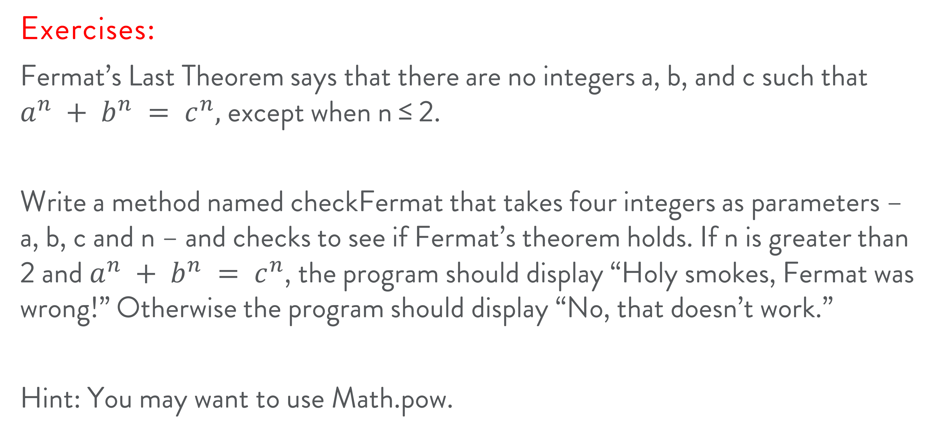
Control flow
Exercises:
Fermat’s Last Theorem says that there are no integers a, b, and c such that $a^{n} + b^{n} = c^{n},$ except when n ≤ 2.
Write a method named checkFermat that takes four integers as parameters – a, b, c and n – and checks to see if Fermat’s theorem holds. If n is greater than 2 and $a^{n} + b^{n} = c^{n}$, the program should display “Holy smokes, Fermat was wrong!” Otherwise the program should display “No, that doesn’t work.”
Hint: You may want to use Math.pow.

Slide 47



